Slide 1



&
&
...with a little bit o'
on the side.

Slide 2
Gitting to know each other
Cedric Kim A Sarmenta
Senior Software Engineer @ Aestrea Software Development
cedric.sarmenta@aestrea.com
@cedzsarmenta
github account: cedrickimsarmenta

Slide 3
Challenges with developing software
Source code always changes. How do we track its history?
How do we collaborate with other developers effectively?
Where do we store our source code?
Without git and other scms, how do we address these challenges?

Slide 4
Keeping track of file history
HelloWorld.java.bak, HelloWorld.java.bak2, HellWorld.java.bka3
_072211.java, _072311.java, _072311-1200PM.java, _072311-0733.PM
thesis-1, thesis-2, thesis-final, thesis-final2, thesis-final-na-talga, thesis-sana-final-na-talaga
paste code into temporary random file i.e. untitled.txt
working-072211.zip, _072311.zip

Slide 5
Storing source code
usb/cd
email
hard copy
diskette?
master computer/laptop (won’t crash, tiwala lang)

Slide 6
Collaboration
Eto oh usb copy paste mo
One-laptop-to-rule-them-all
HelloWorld_Cedz.java, HelloWorld_Bryan.java lets volt in!
Maganda-gawa-ko.html, Mas-maganda-gawa-ko-scrap-na-iyung-sayo.html
leader-e2-ung-files.zip
Subject: HelloWorld.java ni Bryan - 2:16PM (p.s dinagdag ko na pala yung sorting :))
Re: Subject: HelloWorld.java ni Bryan - 2:16PM -- Di gumana!!!

Slide 7

Barbaric Version Control

Slide 8

Enter, git...

Slide 9
Git is a source code management tool
A.k.a version control/revision control
Manages changes to source code
Allows multiple developers to collaborate with one another
Code is stored in repositories

Slide 10
Popular source code management tools
Subversion
CVS
Mercurial
Git

Slide 11
A little intro for git
Created by Linus Torvalds (linux kernel)
http://git-scm.com
Fast
Open source
Distributed
Popularly hosted by github and bitbucket
Has protection against corruption

Slide 12
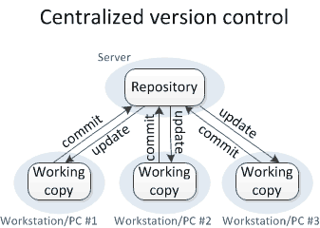
Distributed vs Centralized version control

Slide 13
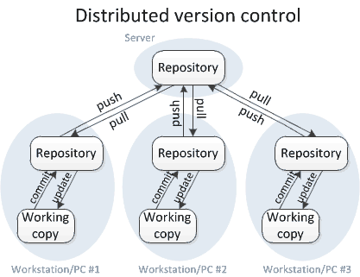
Distributed vs Centralized version control

Slide 14

Time for some git action

Slide 15
Installation
For linux:
- sudo apt-get install git
- sudo apt-get install gitk
- sudo apt-get install git-gui
- you're done!
For other OS:
Please see http://git-scm.com/download

Slide 16
Our sample repository
git@github.com:cedrickimsarmenta/gitsample.git

Slide 17
Git commands
You can always use git [command] --help for documentation
gitk and git gui are useful tools for using git

Slide 18
Git commands
init
commit
clone
amend
revert
fetch
push
pull
merge
rebase

Slide 19

Questions?

Slide 20
Groovy
http://groovy.codehaus.org
Dynamic language for the Java Virtual Machine
Similar to python, ruby, php
Java codes will still work on groovy
With added features such as closures, builders, and dynamic typing that makes a programmer's life easier

Slide 21
Groovy examples
http://groovyconsole.appspot.com

Slide 22
Questions?

